Slide 1

Road Repair Request system
CHAMELI DEVI GROUP OF INSTITUTIONS
INDORE
Guide Student
Mr. Sachin Sharma Murtaza Mehmudji
Nilesh Prajapat
Rajnish Pratap Singh
ChandraPratap Singh
Mandloi

Slide 2
Contents
Introduction
Objective
Flow Chart
Problem Domain
Solution Domain
System Domain
Analysis & Design
Appendix

Slide 3
Introduction
Road Repair System is the web application to solves all kind of cracks damages in the roads. The purpose of this software is to manage the roads in the city. We develop this software to maintain proper and suitable roads. This project is developed using HTML, CSS, JAVASCRIPT and JQUERY as front end and NODEJS as back end. Here we are trying to develop such type of system which report a porthole or road defect. Admin repairs portholes and other road defects to ensure safe access for all road users, and maintain the structure of the road or footway in accordance with our highway safety inspection manual. In auto road repair system there are few steps:-
User can request with some details; which area roads are defected or cracks by capturing photos and submitted on the application.
Allocated area supervisor taking all information of defected roads.
Supervisor allots a right contactor is a hand applied product that eliminates the contamination of adjacent areas, which can be problematic with other patch repair products its benefits include.

Slide 4
OBJECTIVE
To acquire better road conditions by working on a convenient way to send details about bad road conditions in an area and get roads repaired in that area.
This may lead to less probability of traffic and accidents.

Slide 5
User Request
Request Delivers to Admin
Admin Request for Quotation from Contractor
Contractor Sends Quotation with the Materials used
Admin selects contractor and send conformation request to user
User accepts and gives feedback after completion of work
WORKING

Slide 6
Admin
Contractor
User
Engineer
USER LEVELS

Slide 7
Problem Domain
The government cannot look after all the road conditions across India. Thus, people are facing problems regarding the condition of roads. Through this application people can request for repairs of roads having worst conditions.
The objectives of this application are: -
To obtain people with a platform to deliver their request.
To accommodate contractors to increase their work ability and business as well.
To validate the condition of roads by the user after being repaired.

Slide 8
Solution Domain
Design Plan: -
The user request for a road repair in the area where he is facing problem. The request goes to an administrator. The administrator generates a request for quotation to the contractors. The contractor sends the required quotation along with the material used.
The administrator then allots the project to the best suitable contractor. The contractor starts the work. After the work being completed, the administrator sends a confirmation request to the user. The user accepts the request after verifying that the road has been successfully repaired and gives his relevant feedback.

Slide 9
System Domain
Requirements
1GB RAM
Dual Core processor
An updated web browser for better performance
NODEJS platform
Technology
NODEJS
HTML5
CSS3
Node Modules
StarUML
Bootstrap
MongoDB
Environment
Web Based

Slide 10
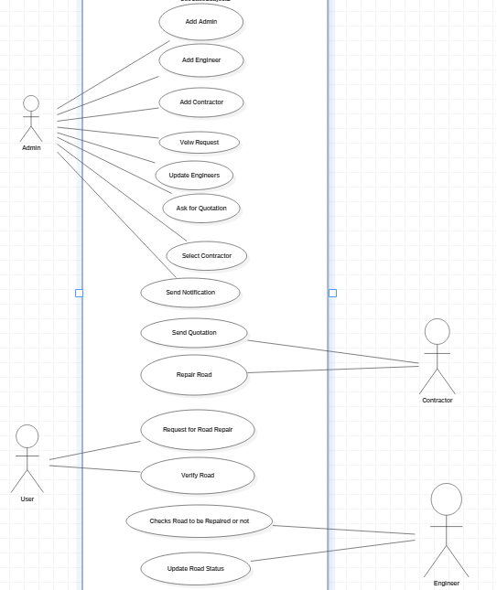
ANALYSIS AND DESIGN
Use Case

Slide 11
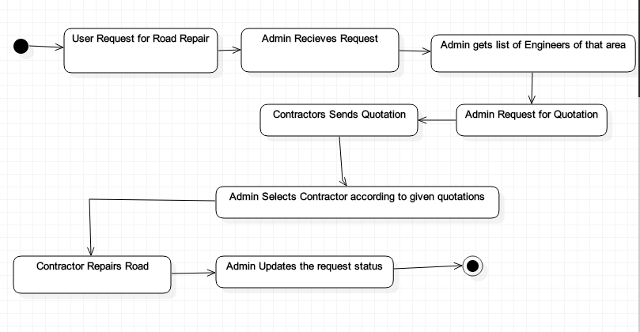
Activity Diagram

Slide 12
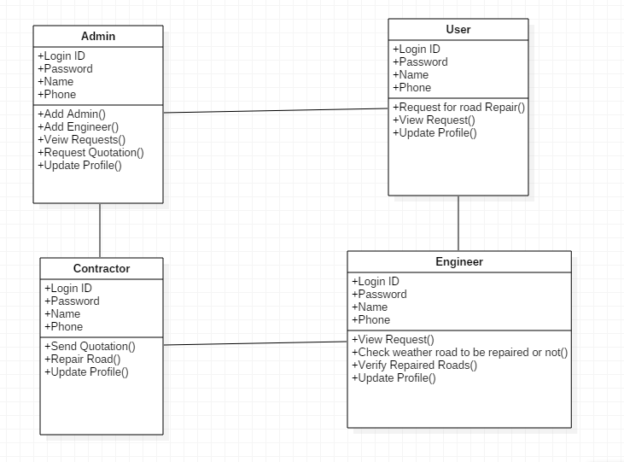
Class Diagram

Slide 13
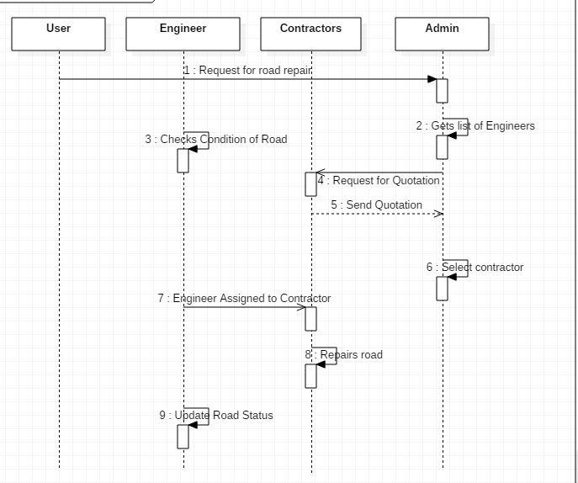
Sequence Diagram

Slide 14
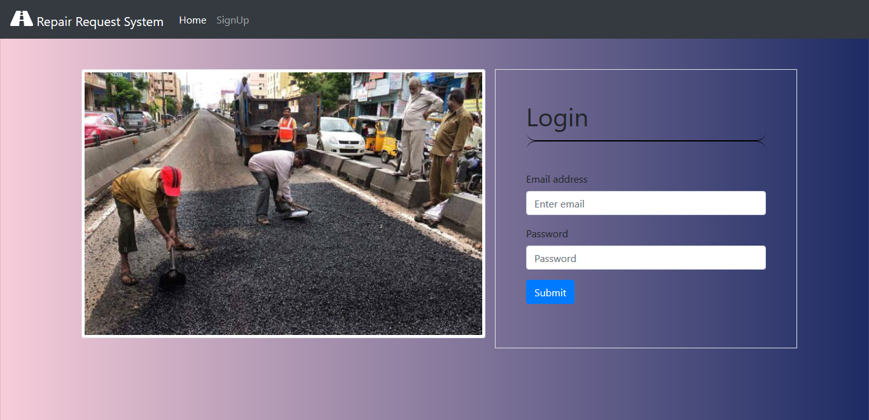
Login Page

Slide 15
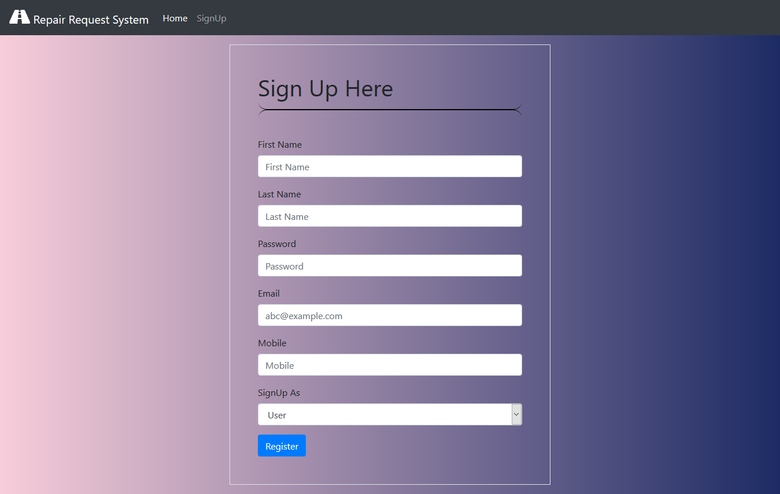
Sign Up

Slide 16
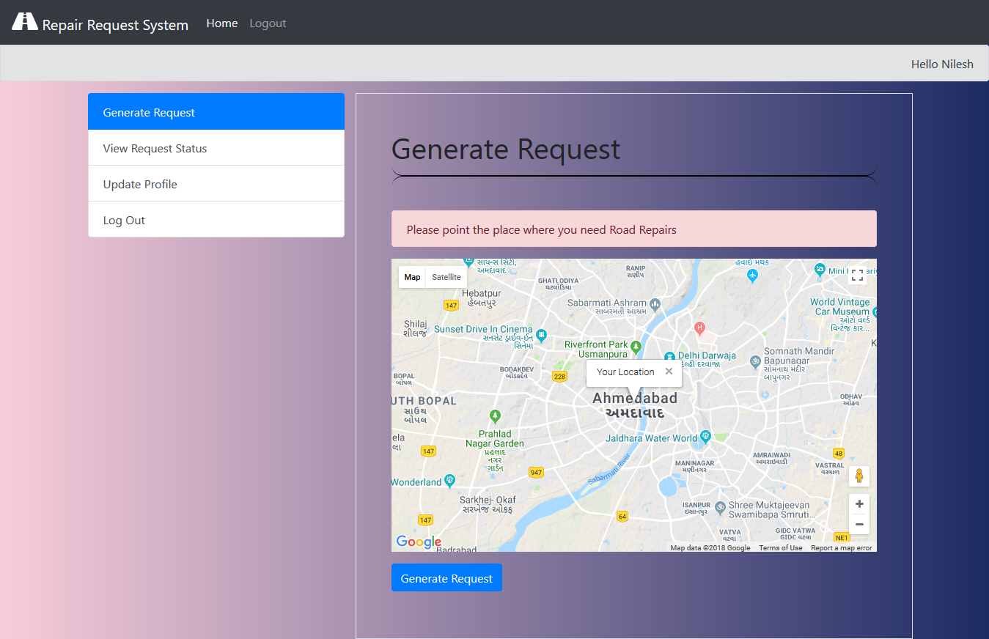
Generate Request

Slide 17
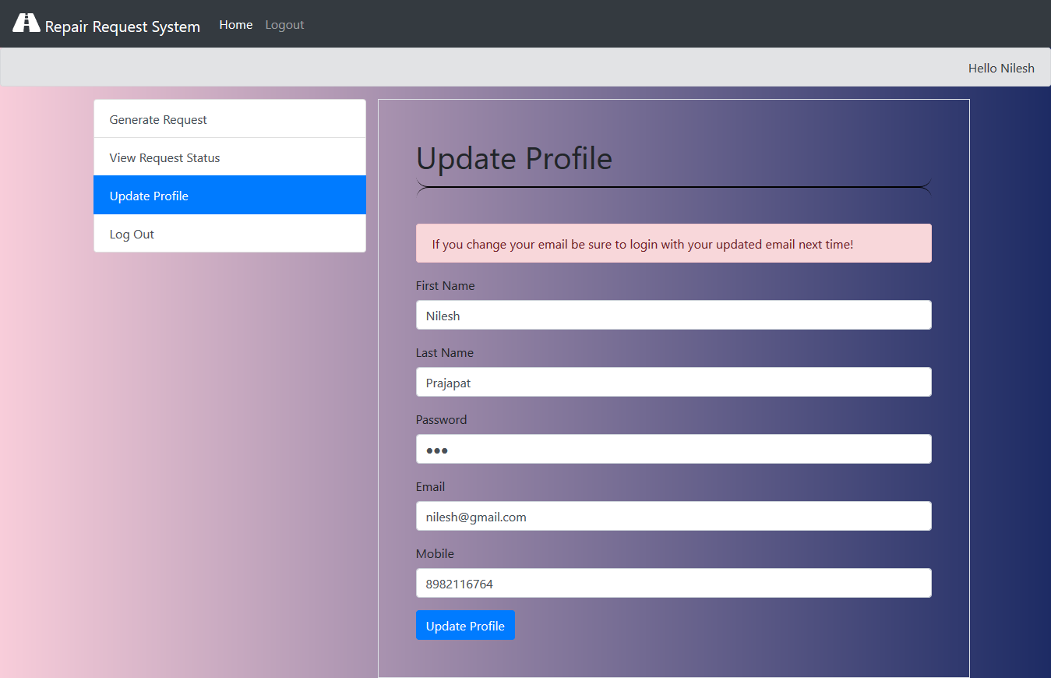
Update Info

Slide 18
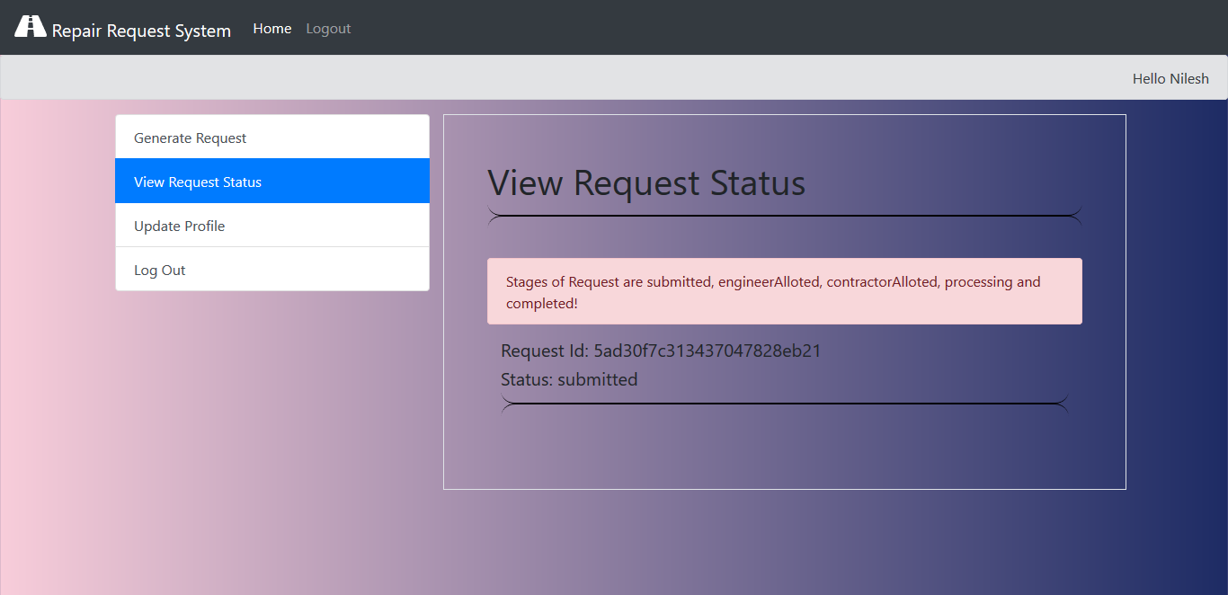
Request Status

Slide 19
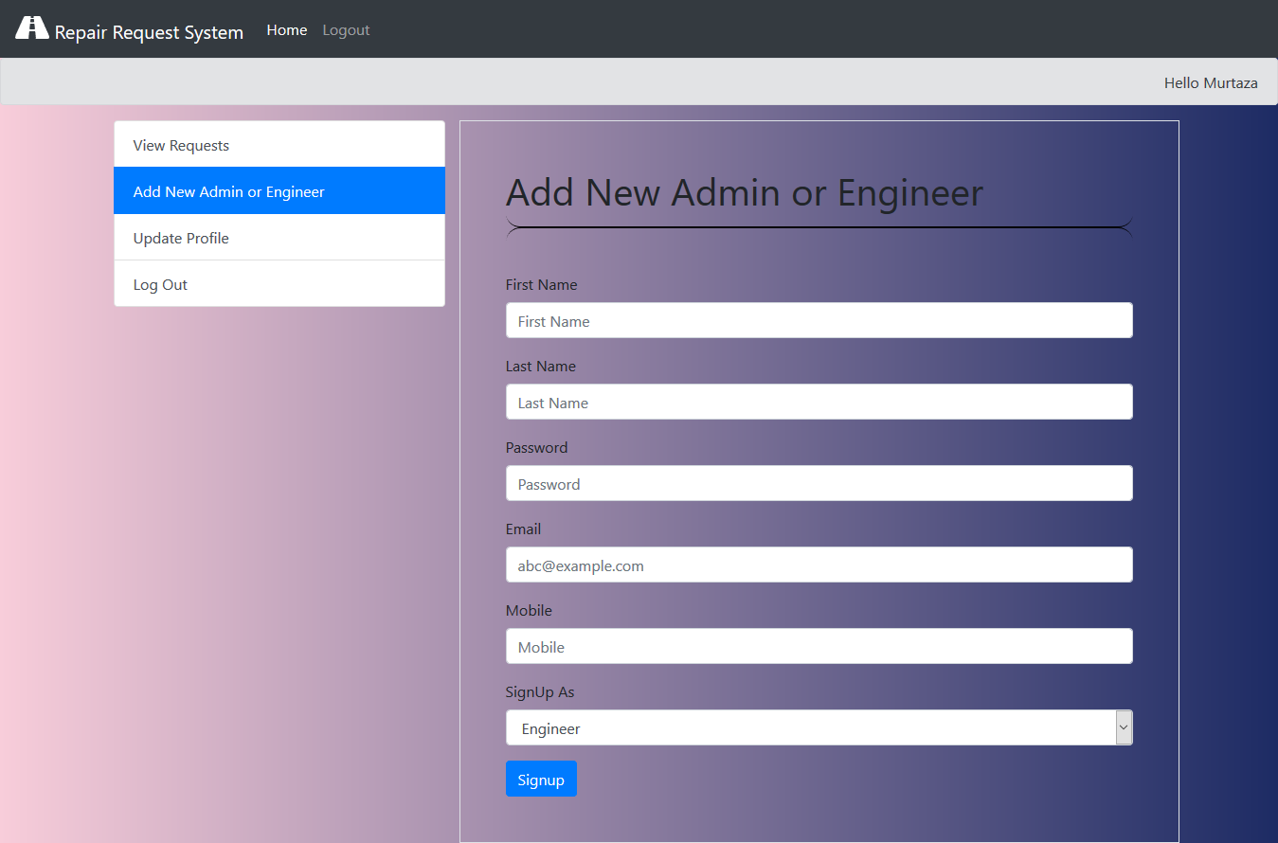
Add Admin or Engineer

Slide 20
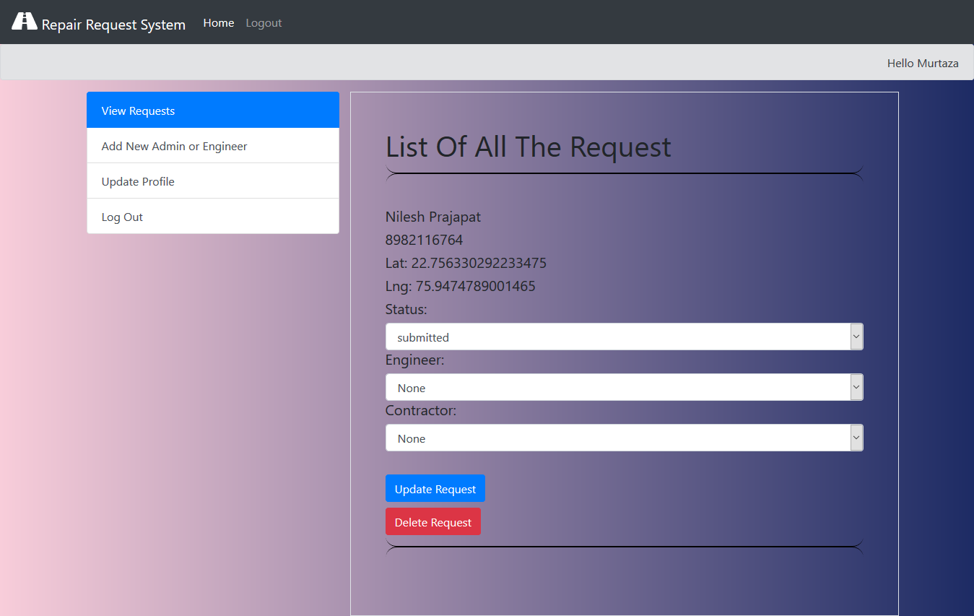
List of Request

Slide 21
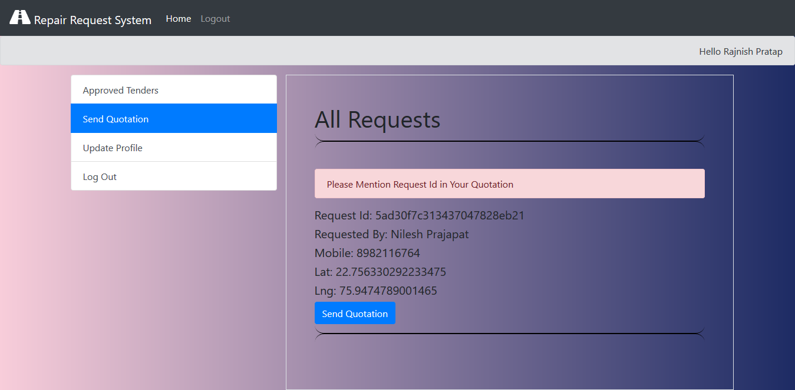
Generated Request

Slide 22
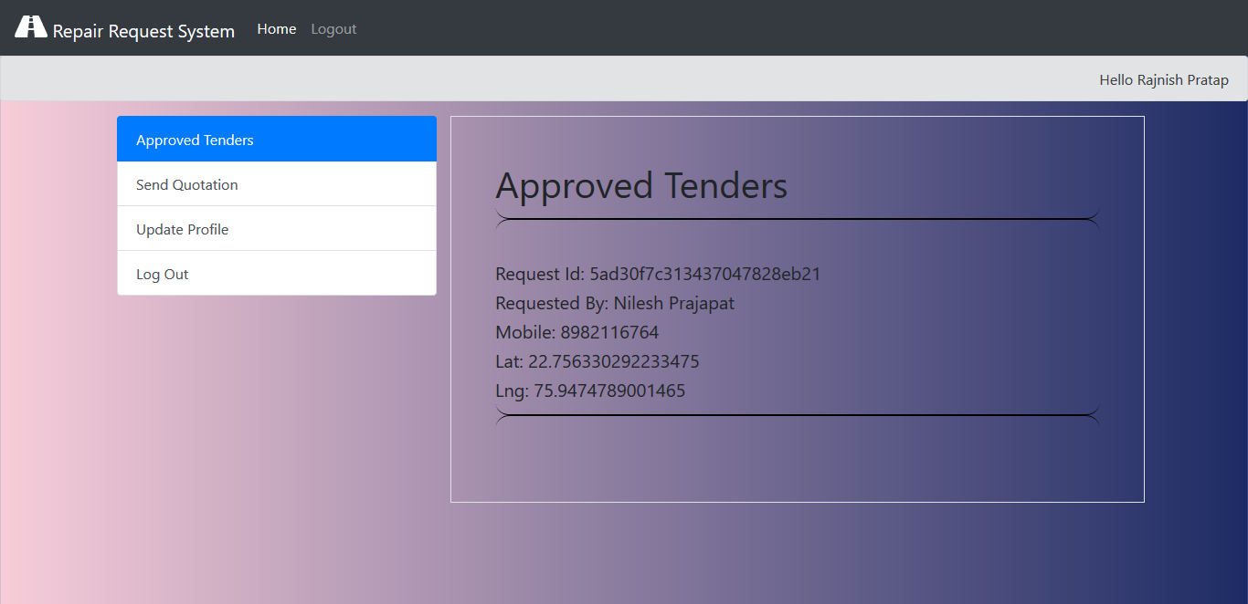
Tenders

Slide 23
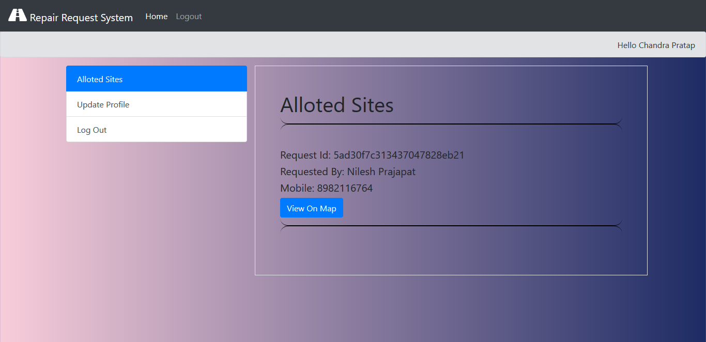
Allotted
Sites for
Engineer

Slide 24
Group Members
Murtaza Mehmudji 0832IT151019 Murtazamehmudji@gmail.com
Nilesh Prajapat 0832IT151022 Prajapatn95@gmail.com
Rajnish Pratap Singh 0832IT151033 Rajnishpratap01@gmail.com
Chandrapratap Singh Mandloi 0832IT151009 Mandloi.parth@gmail.com

Slide 25
THANK YOU

